Slide 1



Research Article No. 3
SSSP in Large-Scale
Dynamic Networks
Parallel and Dristributed computing
Emaan Ali i222325 | Wania Naeem i222369 | Nabeeha Shafiq i222336

Slide 2


Introduction
World Problems consists of grap-like structures
SSSP (single source shortest path) is a building block for many networks
Why do we require parallelized Techniques?
For dynamic graphs , recomputing SSSP tree from scratch is inefficient
The article proposes a parallel algorithm template to
update and compute the SSSP tree dynamically

Slide 3


Shared Memory Parallelization
CPU- Based (OpenMP)
Udates are handled in batches
Dynamic schedueling is used to balance load
Uses load buffer per thread
In parallel loop mark verticies affected by deletion or insertion
Iterate until no affacted vertices remains
Deletion: disconnect affected vertices and mark subtree
Insertion : if a better path is found update distance and mark children
Each update round is done in parallel avoiding locks where possible

Slide 4

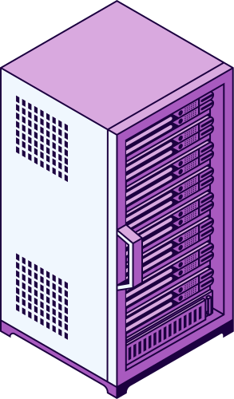
Shared Memory Template
Parallel SSSP Update Framework
Step#01 Identifying affected vertices
Run each edge in parallel and find the affected vertices
Edges are inserted or deleted
Can run in parallel without synchronization
EX
A
B
X
C
If B-->C is detected, then C’s parent is removed,
so C vertex is affected.

Slide 5
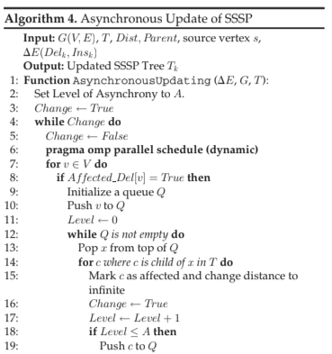
Shared Memory Template
Step#02 Update affected subgraph
only affected part are recalculated
Deletion : removes affected branches
Insertion: Relax path through new edges
if shorter path is created, parents and children are updated
EX
A
B
C
X
D

Slide 6



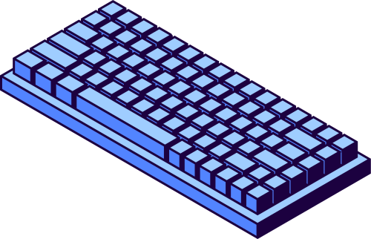
CPU BASED PERFORMANCE EVALUATION
5X Speed vs basline method (galois)
A syncronous function is faster than synchronous
Speed improves with:
Fewer aqffected nodes
2.Larger batch size
3.More threads

Slide 7
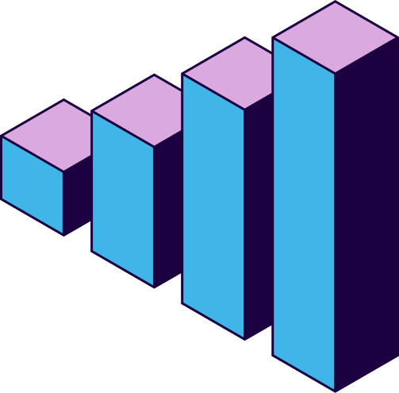

GPU- Based Parallelization
Strategy
Step A – Detect & mark (inside each computer, OpenMP)
Step C – Fix distances locally (OpenMP loop)
Every CPU core scans its own chunk.
If a vertex’s shortest path might change ⇒ set Affected = true.
While there’s an affected list on this computer:
Many cores in parallel relax edges of those vertices.
Better path to local neighbour? → put that neighbour on the next local list.
Better path to remote neighbour? → queue a message for its owner (MPI Send Recv Used here).Step D
Step B – Tell other computers (MPI)
For any affected vertex that actually lives on another computer, send a tiny “vertex X is affected” message.

Slide 8


Step D – Swap those improvements (MPI)
Ship out queued updates; receive others.
Incoming updates adjust ghost‑vertex distances and may add new locals to the list.
Step E – Are we done? (MPI All‑reduce)
All computers say whether their list is now empty.
If everyone is empty ⇒ finished.
Otherwise, go back to Step C and keep relaxing ie updating shorter paths
METIS splits once, OpenMP drives the work inside each node, and MPI only passes the “what changed” nuggets across nodes until no more improvements are found.

Slide 9
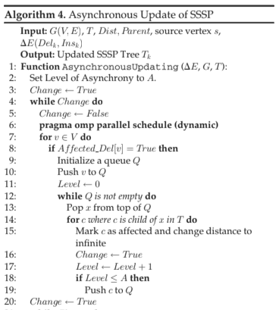
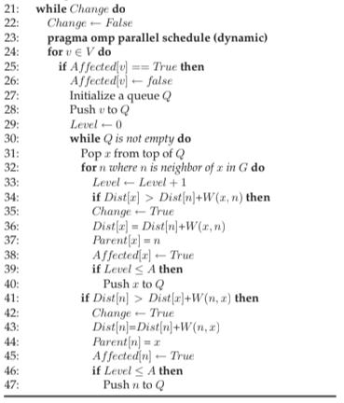

Udates are handled in batches
Dynamic schedueling is used to balance load
Uses load buffer per thread
In parallel loop mark verticies affected by deletion or insertion
Iterate until no affacted vertices remains
Deletion: disconnect affected vertices and mark subtree
Insertion : if a better path is found update distance and mark children
Each update round is done in parallel avoiding locks where possible

Slide 10



Conclusion
The framework is scalable and adaptable across hardware:
OpenMP for multi-core CPUs.
CUDA-based GPU implementation (VMFB) for highly parallel execution.
MPI-based distributed version for massive graphs across multiple machines.
The asynchronous approach reduces synchronization overhead and enhances performance significantly.
Parallelizing SSSP updates enables efficient handling of real-time changes in massive graphs — making it ideal for dynamic networks like social graphs, traffic systems, and communication networks.

Slide 11

Thank You!

